Slide 1


COIMBATORE INSTITUTE OF TECHNOLOGY
Government Aided Autonomous Institution Approved By AICTE,
New Delhi and Affiliated To Anna University, Chennai - 600025
PATENT MANAGEMENT SYSTEM USING MACHINE LEARNING AND BLOCKCHAIN
PROJECT GUIDE :
Ms.G.THILAGAVATHI
ASSISTANT PROFESSOR,
DEPARTMENT OF INFORMATION TECHNOLOGY,
COIMBATORE INSTITUTE OF TECHNOLOGY
PRESENTED BY :
KISHOR KUMAR K - 2007029
THURKARAMAN R - 2007050
PRATHEEP R - 71762107204

Slide 2

CONTENTS
Abstract
Literature survey
Patent Granting Process
Limitations of existing system
Proposed system
Advantages of Proposed system
Module 1
System architecture
Conclusion
References

Slide 3
ABSTRACT
In today's innovation-driven world, intellectual property rights, particularly patents, play a pivotal role in protecting and incentivizing creators and inventors. However, the management of royalty payments for patent holders and the broader issue of tokenizing patents for enhanced liquidity have posed challenges within the traditional systems. To address these challenges, we propose a Blockchain-based Royalty Payment and Patent Tokenization System.Our project aims to leverage the decentralized and transparent nature of blockchain technology to revolutionize the way royalty payments are managed for patent holders. By implementing a smart contract-based approach, the system automates the calculation and distribution of royalty payments in real-time, ensuring accuracy, transparency, and security. Additionally, the integration of self-executing smart contracts eliminates intermediaries, reducing costs and delays in the payment process.In conclusion, by harnessing the power of blockchain technology, the project addresses the challenges of royalty payment management and introduces a novel approach to patent tokenization, fostering innovation, collaboration, and efficiency in the realm of intellectual property.

Slide 4
LITERATURE SURVEY
TITLE | YEAR | AUTHOR | METHODS USED | LIMITATIONS
Intellectual Property Management Using Blockchain | 2018 Journal: IEEE | Ajay K, Bharath B, Akhil M V, Akanksh R | smart contracts | Only transaction can be performed
Blockchain-based Intellectual Property Management Using Smart Contracts | 2022 Journal: IEEE | C. S. Wanigasooriya; A. D. A. I. Gunasekara | smart contracts | Theoretical approach
Blockchain and its applications in Intellectual Property Rights Management | 2023 Journal: IEEE | Gourab Paik; Garvit Chhatani; Ayan Sharma; R. K. Yadav | counterfeit transaction detection mechanism in blockchain based systems | ownership detail is not considered
Intellectual Property Protection using Blockchain and Digital Watermarking | 2021 Journal: IEEE | Saumya Bhadauria; Pranjal Kumar; Tamanna Mohanty | store the transaction details and the watermark information in blockchain | Fractional ownership is not possible

Slide 5
LITERATURE SURVEY
A blockchain-based platform for smart contracts and intellectual property protection for the additive manufacturing industry | 2022 Journal: IEEE | Abhiram Haridas; Adil Abdul Samad; Vysakh D; Deepak Lawrence K; Vinod Pathari | smart contracts | abstract design
Using Blockchain Technology to Enhance the Traceability of Original Achievements | 2021 Journal: IEEE | Peng Zhu; Jian Hu; Xiaotong Li; Qingyun Zhu | embedded automatic incentive rewarding mechanism for both the creation and protection of original achievements | transaction are not maintaine
Blockchain-Based Traceability and Management for Additive Manufacturing | 2020 Journal: IEEE | Wala’ Alkhader; Nouf Alkaabi; Khaled Salah; Raja Jayaraman; Junaid Arshad | smart contracts and ledgers | ownership details can't be found

Slide 6
PATENT GRANTING PROCESS
Patent Application: This is the initial step where you submit your complete patent application to the relevant patent office, which includes a detailed description of your invention, claims that define its scope, and any necessary drawings or diagrams.
Request for Examination: After your patent application is filed, the official examination process is initiated where the patent office assesses your application for patentability criteria, such as novelty, non-obviousness, and utility.
First Examination Report: Once the examination is conducted, the first examination report outlines any issues, objections, or rejections raised by the patent examiner regarding your application.

Slide 7
PATENT GRANTING PROCESS
Compliance: Based on the First Examination Report, you need to address the issues raised by the examiner. You can amend your application, provide explanations, or make necessary changes to overcome objections.
Grant: If the patent office is satisfied with your responses to the First Examination Report and determines that your application meets all patentability criteria, they issue a formal patent grant.
Annuity Payment: Once your patent is granted, you're required to make periodic annuity payments or maintenance fees to the patent office to keep your patent in force.

Slide 8
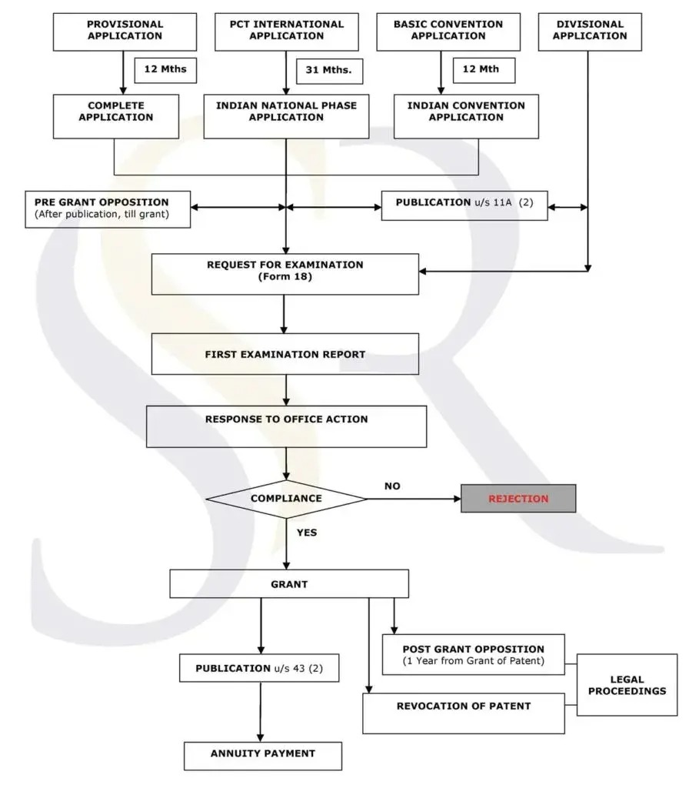
PATENT GRANTING PROCESS

Slide 9
LIMITATIONS OF EXISTING SYSTEM
Manual and Complex Processes: Traditional royalty payment systems often involve manual calculations, paperwork, and intermediaries, leading to delays and errors in royalty distribution.
Intermediaries and High Costs: Traditional patent management involves intermediaries such as licensing agencies, legal advisors, and brokers. These intermediaries introduce additional costs and complexity, which can reduce the revenue that patent holders receive.

Slide 10
PROPOSED SYSTEM
The system utilizes smart contracts, which are self-executing code running on the blockchain.
Smart contracts automate the entire royalty payment process. When a patent is licensed or generates revenue, the smart contract automatically calculates and distributes royalties to the patent holders based on predefined terms and conditions.
All transactions related to patent ownership, licensing agreements, and royalty payments are recorded on a decentralized and transparent blockchain ledger.

Slide 11
ADVANTAGES OF PROPOSED SYSTEM
Transparency and Trust: The blockchain's inherent transparency ensures that all transactions, ownership transfers, and royalty calculations are recorded immutably on the distributed ledger.
Tokenized Ownership: Patent tokenization enables fractional ownership, making it possible for a broader range of investors to invest in patents. This democratizes access to patent investments, encouraging more people to support innovation.

Slide 12
MODULE 1

Slide 13
BERT
BERT, which stands for "Bidirectional Encoder Representations from Transformers," is a deep learning model for natural language processing (NLP) developed by Google in 2018.
One of the main innovations of BERT is that it's bidirectional, meaning it can consider both the left and right context of a word in a sentence. This bidirectional understanding of context helps it capture richer contextual information compared to previous models that processed text sequentially.

Slide 14
TF-IDF
TF-IDF (Term Frequency-Inverse Document Frequency) is a numerical statistic that is used to represent the importance of a word or term in a document relative to a collection of documents (a corpus). It is commonly used in information retrieval and text mining for various natural language processing tasks, such as document retrieval, document classification, and clustering.

Slide 15
COSINE SIMILARITY
Cosine similarity is a metric used to measure how similar two non-zero vectors are. In the context of natural language processing and text analysis, it is commonly used to determine the similarity between two documents or pieces of text.

Slide 16
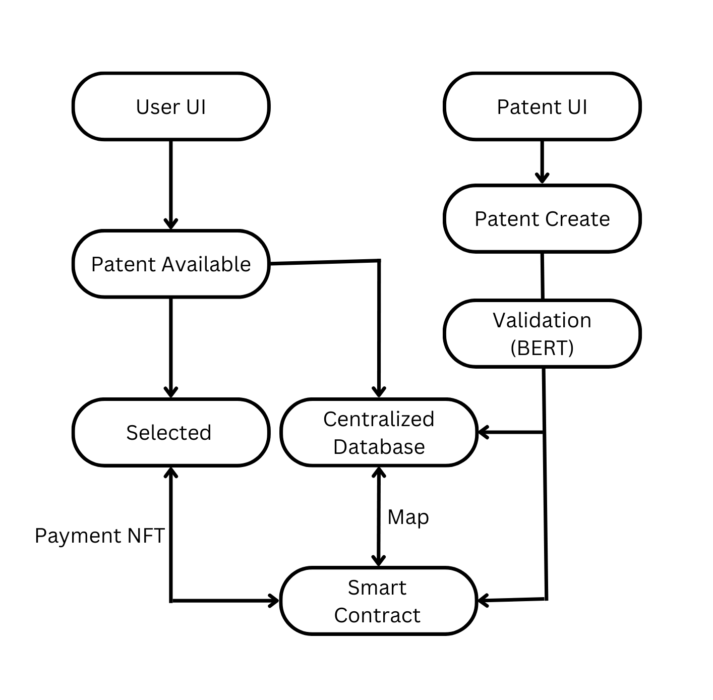
SYSTEM
ARCHITECTURE

Slide 17
CONCLUSION
The Blockchain-based Royalty Payment and Patent Tokenization System presented in this project offer a promising solution to the longstanding challenges in managing royalty payments and unlocking the value of patents. Through the implementation of smart contracts, the project ensures accurate and timely royalty payments to patent holders while eliminating the need for intermediaries.

Slide 18
REFERENCES
Ajay K, Bharath B, Akhil M V, Akanksh R, ”Intellectual Property Management Using Blockchain”November 15,2018 - DOI: 10.1109/ICICT43934.2018.9034295
C. S. Wanigasooriya; A. D. A. I. Gunasekara; K. G. K. G. Kottegoda, “Blockchain-based Intellectual Property Management Using Smart Contracts”May 27,2022 - DOI: 10.1109/INCET54531.2022.9824855
Gourab Paik; Garvit Chhatani; Ayan Sharma; R. K. Yadav,”Blockchain and its applications in Intellectual Property Rights Management”April 28,2023 - DOI: 10.1109/CISES58720.2023.10183512
Saumya Bhadauria; Pranjal Kumar; Tamanna Mohanty,”Intellectual Property Protection using Blockchain and Digital Watermarking”December 13,2021 - DOI: 10.1109/ANTS52808.2021.9936909
Abhiram Haridas; Adil Abdul Samad; Vysakh D; Deepak Lawrence K; Vinod Pathari,”A blockchain-based platform for smart contracts and intellectual property protection for the additive manufacturing industry”March 10,2022 - DOI: 10.1109/SPICES52834.2022.9774219

Slide 19
REFERENCES
Peng Zhu; Jian Hu; Xiaotong Li; Qingyun Zhu,”Using Blockchain Technology to Enhance the Traceability of Original Achievements”April 15,2021 - DOI: 10.1109/TEM.2021.3066090
Wala’ Alkhader; Nouf Alkaabi; Khaled Salah; Raja Jayaraman; Junaid Arshad,”Blockchain-Based Traceability and Management for Additive Manufacturing”Octob 15,2020 - DOI: 10.1109/ACCESS.2020.3031536

Slide 20
THANK YOU!

